Slide 1
Chapter 2
E-Marketplaces: Structures, Mechanisms, Economics, and Impacts

Slide 2
Learning Objectives
Define e-marketplaces and list their components.
List the major types of e-marketplaces and describe their features.
Describe the various types of EC intermediaries and their roles.
Describe electronic catalogs, shopping carts, and search engines.
Describe the major types of auctions and list their characteristics.

Slide 3
Learning Objectives
Discuss the benefits, limitations, and impacts of auctions.
Describe bartering and negotiating online.
Define m-commerce and explain its role as a market mechanism.
Discuss competition in the digital economy.
Describe the impact of e-marketplaces on organizations and industries.

Slide 4
E-Marketplaces
e-marketplace
An online market, usually B2B, in which buyers and sellers exchange goods or services; the three types of
e-marketplaces are private, public, and consortia

Slide 5
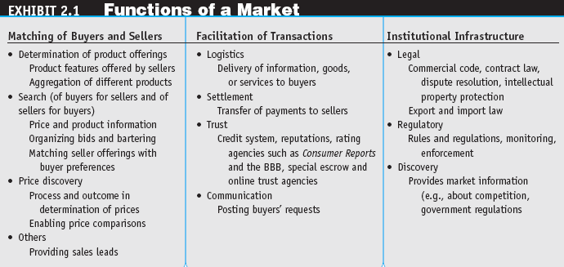
E-Marketplaces

Slide 6
E-Marketplaces
marketspace
A marketplace in which sellers and buyers exchange goods and services for money (or for other goods and services) but do so electronically

Slide 7
E-Marketplaces
E-Marketplace Components and Participants
Customers
Sellers
Products and services
  digital products
  Goods that can be transformed to digital format and delivered over the Internet
Infrastructure
Front end
Back end
Intermediaries
Third parties that operates between sellers and buyers
Other business partners
Support services

Slide 8
E-Marketplaces
front end
The portion of an e-seller’s business processes through which customers interact, including the seller’s portal, electronic catalogs, a shopping cart, a search engine, and a payment gateway
back end
The activities that support online order fulfillment, inventory management, purchasing from suppliers, payment processing, packaging, and delivery

Slide 9
Types of E-Marketplaces:
From Storefronts to Portals
Electronic Storefronts
  storefront
  A single company’s Web site where products or services are sold
  e-mall (online mall)
  An online shopping center where many online stores are located
  Visualization and virtual realty in shopping malls

Slide 10
Types of E-Marketplaces:
From Storefronts to Portals
Types of Stores and Malls
  General stores/malls
  Specialized stores/malls
  Regional versus global stores
  Pure-play online organizations versus click-and-mortar stores

Slide 11
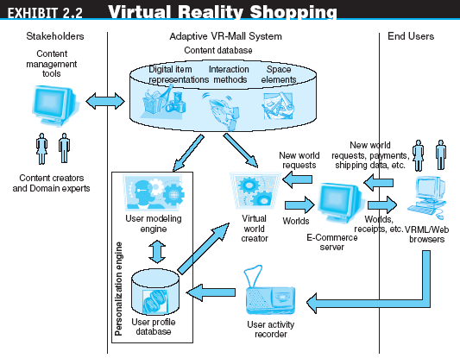
Types of E-Marketplaces:
From Storefronts to Portals

Slide 12
Types of E-Marketplaces:
From Storefronts to Portals
Types of E-Marketplaces
  private e-marketplaces
  Online markets owned by a single company; may be either sell-side and/or buy-side e-marketplaces
  sell-side e-marketplace
  A private e-marketplace in which one company sells either standard and/or customized products to qualified companies
  buy-side e-marketplace
  A private e-marketplace in which one company makes purchases from invited suppliers

Slide 13
Types of E-Marketplaces:
From Storefronts to Portals
Types of E-Marketplaces
  public e-marketplaces
  B2B marketplaces, usually owned and/or managed by an independent third party, that include many sellers and many buyers; also known as exchanges

Slide 14
Types of E-Marketplaces:
From Storefronts to Portals
information portal
A single point of access through a Web browser to business information inside and/or outside an organization
Types of Portals
  Commercial (public)
  Corporate
  Publishing
  Personal
  Mobile
  Voice
  Knowledge

Slide 15
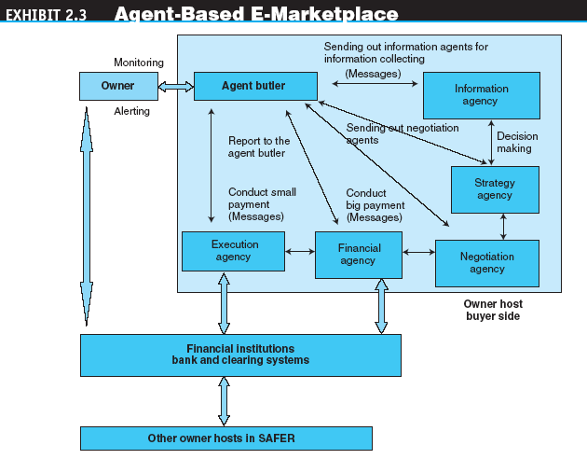
Types of E-Marketplaces:
From Storefronts to Portals

Slide 16
Transactions, Intermediation, and Process in E-Commerce
Sellers, Buyers, and Transactions
  A seller (retailer, wholesaler, or manufacturer) sells to customers
  The seller buys from suppliers: either raw material (as a manufacturer) or finished goods (as a retailer)

Slide 17
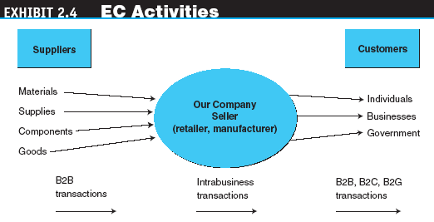
Transactions, Intermediation, and Process in E-Commerce

Slide 18
Transactions, Intermediation, and Process in E-Commerce
The Roles and Value of Intermediaries in E-marketplaces
  infomediaries
  Electronic intermediaries that provide and/or control information flow in cyberspace, often aggregating information and selling it to others

Slide 19
Transactions, Intermediation, and Process in E-Commerce
  A broker is a company that facilitates transactions between buyers and sellers
  Types of brokers
    Buy/sell fulfillment
    Virtual mall
    Metamediary
    Bounty
    Search agent
    Shopping facilitator

Slide 20
Transactions, Intermediation, and Process in E-Commerce
Intermediaries can address the following five important limitations of direct interaction:
  Search costs
  Lack of privacy
  Incomplete information
  Contract risk
  Pricing inefficiencies

Slide 21
Transactions, Intermediation, and Process in E-Commerce
e-distributor
An e-commerce intermediary that connects manufacturers with business buyers (customers) by aggregating the catalogs of many manufacturers in one place—the intermediary’s Web site

Slide 22
Transactions, Intermediation, and Process in E-Commerce
disintermediation
Elimination of intermediaries between sellers and buyers
reintermediation
Establishment of new intermediary roles for traditional intermediaries that have been disintermediated, or for newcomers

Slide 23
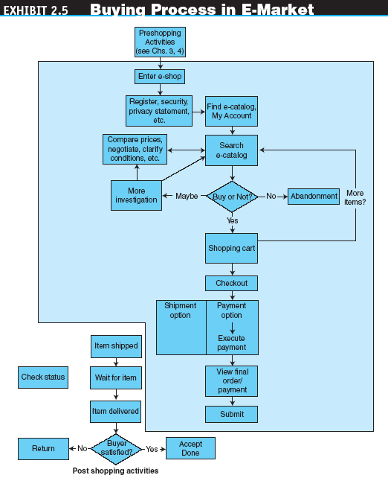
Transactions, Intermediation, and Process in E-Commerce

Slide 24
Electronic Catalogs and Other Market Mechanisms
electronic catalogs
The presentation of product information in an electronic form; the backbone of most e-selling sites
Three dimensions of electronic catalogs:
  The dynamics of the information presentation
  The degree of customization
  Integration with business processes

Slide 25
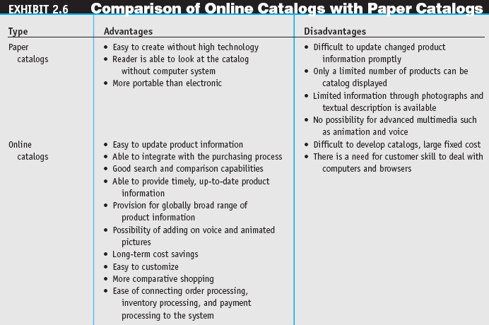
Electronic Catalogs and Other Market Mechanisms

Slide 26
Electronic Catalogs and Other Market Mechanisms
search engine
A computer program that can access databases of Internet resources, search for specific information or keywords, and report the results
software (intelligent) agent
Software that can perform routine tasks that require intelligence

Slide 27
Electronic Catalogs and Other Market Mechanisms
electronic shopping cart
An order-processing technology that allows customers to accumulate items they wish to buy while they continue to shop

Slide 28
Auctions as EC Market Mechanisms
auction
A competitive process in which a seller solicits consecutive bids from buyers (forward auctions) or a buyer solicits bids from sellers (backward auctions). Prices are determined dynamically by the bids

Slide 29
Auctions as EC Market Mechanisms
Traditional Auctions versus
E-Auctions
  Limitations of traditional offline auctions
    rapid process gives potential buyers little time to make a decision
  electronic auction (e-auction)
  Auctions conducted online
dynamic pricing
Prices that change based on supply and demand relationships at any given time

Slide 30
Auctions as EC Market Mechanisms
Types of Auctions
  One buyer, one seller
  One seller, many potential buyers
    forward auction
    An auction in which a seller entertains bids from buyers. Bidders increase price sequentially

Slide 31
Auctions as EC Market Mechanisms
  One buyer, many potential sellers
    reverse auction (bidding or tendering system)
    Auction in which the buyer places an item for bid (tender) on a request for quote (RFQ) system, potential suppliers bid on the job, with the price reducing sequentially, and the lowest bid wins; primarily a B2B or G2B mechanism
    “name-your-own-price” model
    Auction model in which a would-be buyer specifies the price (and other terms) he or she is willing to pay to any willing and able seller. It is a C2B model that was pioneered by Priceline.com

Slide 32
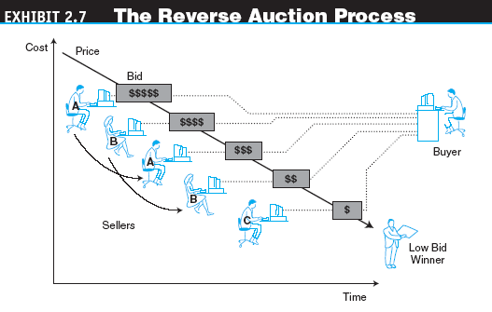
Auctions as EC Market Mechanisms

Slide 33
Auctions as EC Market Mechanisms
  Many sellers, many buyers
    double auction
    Auctions in which multiple buyers and their bidding prices are matched with multiple sellers and their asking prices, considering the quantities on both sides

Slide 34
Auctions as EC Market Mechanisms
Benefits of E-Auctions
  Benefits to Sellers
  Benefits to Buyers
  Benefits to E-Auctioneers
Limitations of E-Auctions
  Minimal security
  Possibility of fraud
  Limited participation

Slide 35
Auctions as EC Market Mechanisms
Impacts of Auctions
  Auctions as a coordination mechanism
  Auctions as a social mechanism to determine a price
  Auctions as a highly visible distribution mechanism
  Auctions as an EC component

Slide 36
Bartering and Negotiating Online
Online Bartering
  bartering
  The exchange of goods or services
  e-bartering (electronic bartering)
  Bartering conducted online, usually in a bartering exchange
  bartering exchange
  A marketplace in which an intermediary arranges barter transactions

Slide 37
Bartering and Negotiating Online
Online Negotiating
  Negotiated pricing commonly is used for expensive or specialized products
  Negotiated prices also are popular when large quantities are purchased
  Much like auctions, negotiated prices result from interactions and bargaining among sellers and buyers

Slide 38
E-Commerce in the Wireless Environment
mobile computing
Use of portable devices, including smart cell phones, usually in a wireless environment. It permits real-time access to information, applications, and tools that, until recently, were accessible only from a desktop computer

Slide 39
E-Commerce in the Wireless Environment
mobile commerce (m-commerce)
E-commerce conducted via wireless devices
m-business
The broadest definition of m-commerce, in which e-business is conducted in a wireless environment

Slide 40
E-Commerce in the Wireless Environment
The Mobility Revolution
  Organizations are embracing mobilized computing technologies for several reasons:
  Improved productivity of workers in the field
  Wireless telecom support for mobility is growing quickly
  More applications can run both online and offline
  The prices of notebook computers, wireless handhelds, and smart phones continue to fall as their capabilities increase

Slide 41
E-Commerce in the Wireless Environment
The Promise of M-Commerce
  location-based commerce (LBC)
  An m-commerce application targeted to a customer whose location, preferences, and needs are known in real time
  M-Commerce Adoption
    Although there are currently many hurdles to the widespread adoption of m-commerce, many companies are already shifting their strategy to the mobile world

Slide 42
Competition in the Digital Economy and Its Impact on Industries
Internet ecosystem
The business model of the Internet economy

Slide 43
Competition in the Digital Economy and Its Impact on Industries
Competitive Factors—Online Transactions Allow:
Lower search costs for buyers
Speedy comparisons
Lower prices
Customer service
Barriers to entry are reduced
Virtual partnerships multiply
Market niches abound
Differentiation and personalization

Slide 44
Competition in the Digital Economy and Its Impact on Industries
differentiation
Providing a product or service that is unique
personalization
The ability to tailor a product, service, or Web content to specific user preferences

Slide 45
Competition in the Digital Economy and Its Impact on Industries
Porter’s Competitive Analysis in an Industry
  competitive forces model
  Model devised by Porter that says that five major forces of competition determine industry structure and how economic value is divided among the industry players in an industry; analysis of these forces helps companies develop their competitive strategy

Slide 46
Competition in the Digital Economy and Its Impact on Industries
Impact on Whole Industries
  Patient self-care is growing rapidly
  The amount of free medical information is exploding
  Patient empowerment is gaining importance
  Increasing electronic interaction among patients, hospitals, pharmacies, etc.
  Increasing digital hospital and other health-care facilities
  Data collected about patients is growing in amount and quality
  Easy and shared access to patient data
  Elder care and special types of care are improving significantly due to wireless systems
  Increasing need to protect patient privacy and contain cost

Slide 47
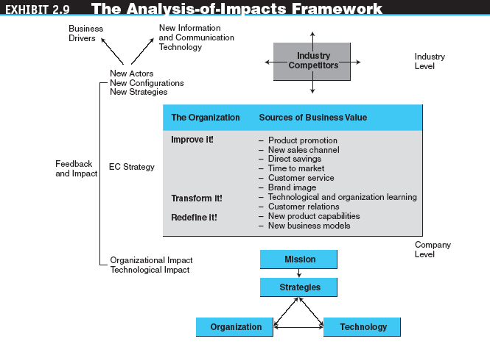
Impacts of EC on
Business Processes and Organizations

Slide 48
Impacts of EC on
Business Processes and Organizations
Impacts of e-marketplaces on B2C direct marketing:
  Product promotion
  New sales channel
  Direct savings
  Reduced cycle time
  Improved customer service
  Brand or corporate image
  Customization
  Advertising
  Ordering systems
  Market operations
  Accessibility

Slide 49
Impacts of EC on
Business Processes and Organizations
Transforming Organizations
  Technology and organizational learning
  The changing nature of work
Redefining Organizations
New and improved product capabilities
New industry order and business models
Improving the supply chain

Slide 50
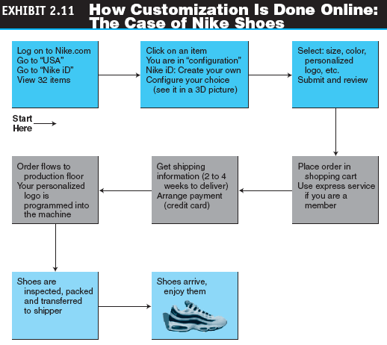
Impacts of EC on
Business Processes and Organizations

Slide 51
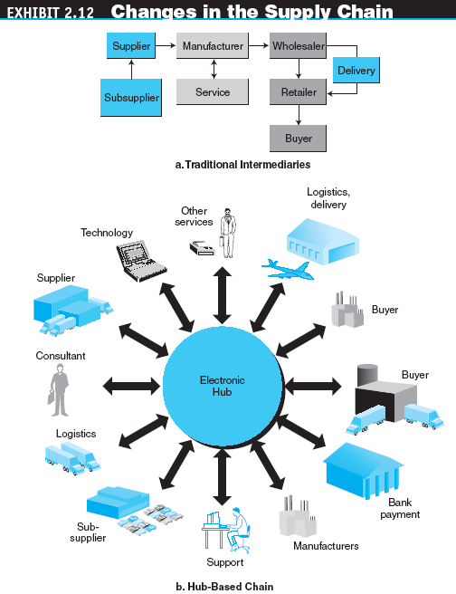
Impacts of EC on
Business Processes and Organizations

Slide 52
Impacts of EC on
Business Processes and Organizations
  Impacts on manufacturing
    Build-to-Order Manufacturing
      build-to-order (pull system)
      A manufacturing process that starts with an order (usually customized). Once the order is paid for, the vendor starts to fulfill it
    Real-Time Demand-Driven Manufacturing
    Virtual Manufacturing
    Assembly Lines
  Impacts on Finance and Accounting
  Impact on Human Resources Management and Training

Slide 53
Managerial Issues
What about intermediaries?
Should we auction?
Should we barter?
What m-commerce opportunities are available?
How do we compete in the digital economy?
What organizational changes will be needed?

